Slide 1

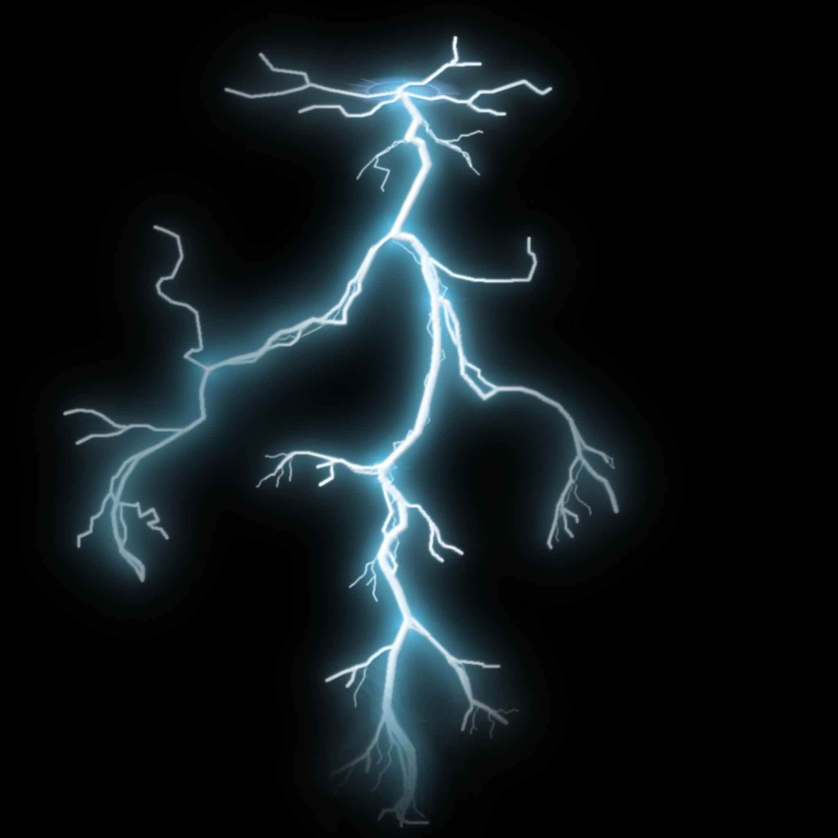
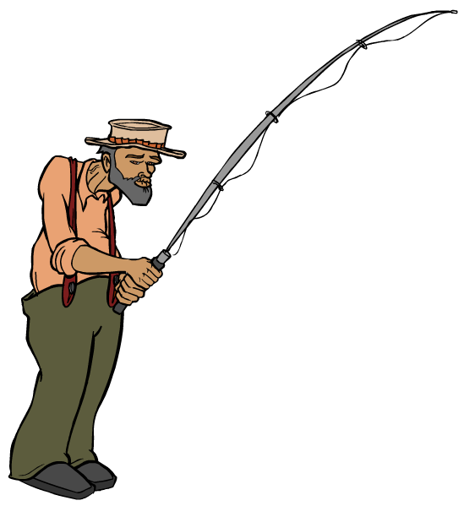

Static Electricity
Explain to this man why fishing in a thunderstorm is a bad idea…

Slide 2
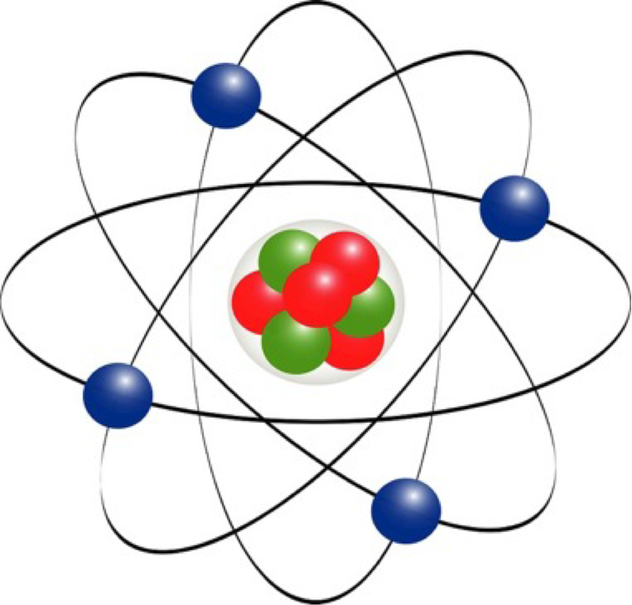
Static Electricity
What has the atom got to do with Static Electricity?
Goal: Explain the parts of an atom and how they are involved in electrostatics.

Slide 3
Static Electricity
The atom is made from neutrons, protons and electrons.
Protons and Neutrons are found in the nucleus of the atom.
Protons are positively charged +
Electrons are negatively charged -
Neutrons are neutrally charged +/-

Slide 4
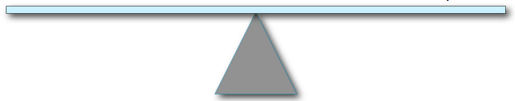
Static Electricity
Protons are positively charged +
Electrons are negatively charged -
Neutrons are neutrally charged +/-
Electrons
Because the number of protons are equal to the number of electrons – the atom is neutral.
Protons

Slide 5


Static Electricity
How do we make static electricity?.
Static electricity is made when electrons are transferred from one material to another. This creates two opposite charged materials.
What does this look like?

Slide 6
Static Electricity
How do we make static electricity?.
Both items contain neutral atoms (balanced amount of protons and electrons)

Slide 7
Static Electricity
How do we make static electricity?.

Slide 8
Static Electricity
How do we make static electricity?.
The balloons have gained electrons from the jumper, becoming overall negatively charged.
The jumper has lost it´s electrons to the balloons and therefore has become overall positively charged.

Slide 9
Static Electricity
How do we make static electricity?.
We have now created an area of negative charge and an area of positive charge. Which the universe is not too happy about.

Slide 10
Purpose: Comparing the affect of charges on the movement of objects.
Question: Which material will attract to the plastic spoon that is rubbed with wool -- the salt or pepper?
Write a hypothesis!
If we rub a plastic spoon with wool, then…

Slide 11
Rub the spoon with wool very quickly.
Hold the spoon over the salt and pepper mixture
See which is attracted to the spoon.
What do you observe?
What happened to cause this? Think about the charge of the spoon and the charge of the salt/pepper

Slide 12
SPOON = Neutral, until it was rubbed with wool. This transferred…
ELECTRONS, causing spoon to become…
NEGATIVE. When it was held over the pepper, the pepper was attracted to the spoon because the pepper is…
POSITIVE

Slide 13
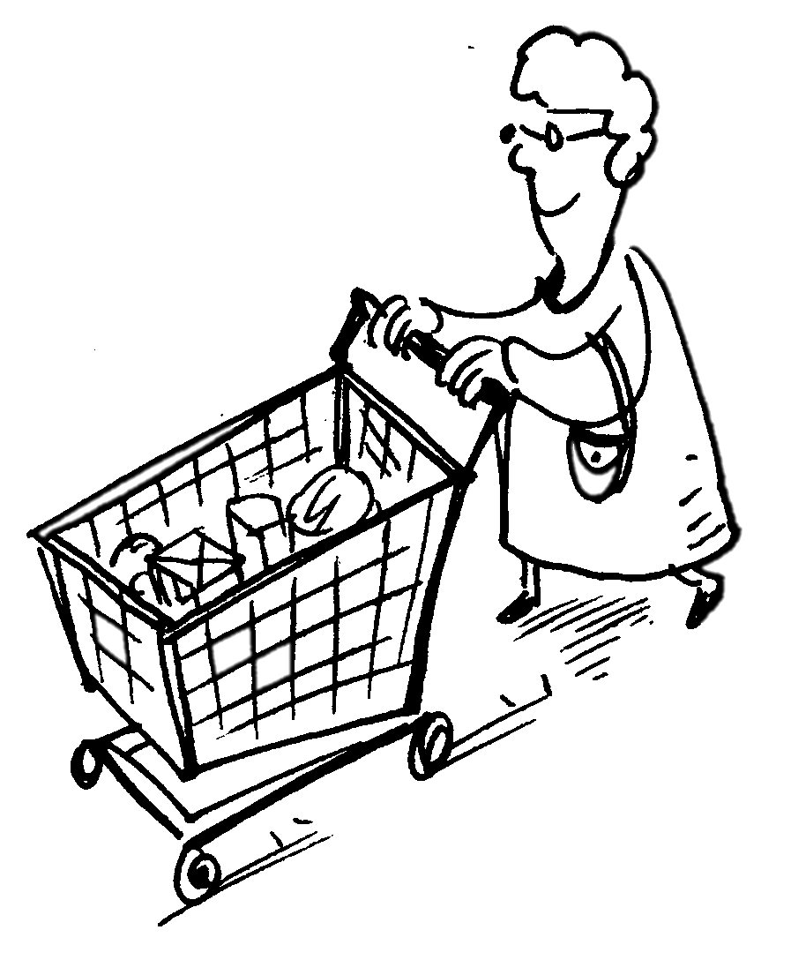
Static Electricity
Shocking Shopping Trolley
We can achieve a static shock (electrical discharge) when a build up of electrons on our body comes into contact with a neutral/positively charged object.
As we mentioned earlier – it is not possible for conducting materials to hold a charge.
So when you grad a shopping cart you may get a little shock as the extra electrons that you have been carrying around all day – discharge (jump) to the shopping trolley as you get close to it.
Ouch!

Slide 14
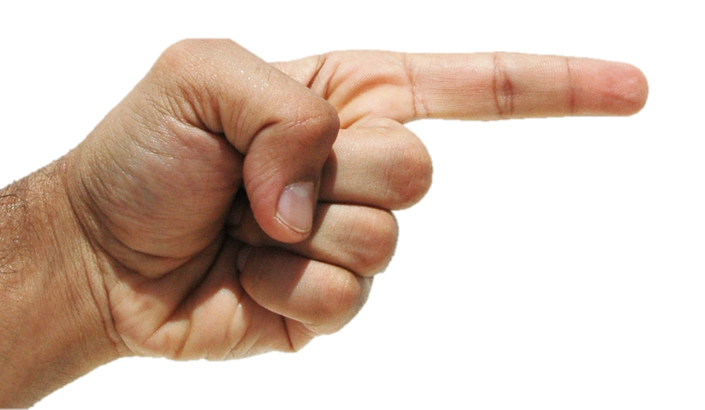
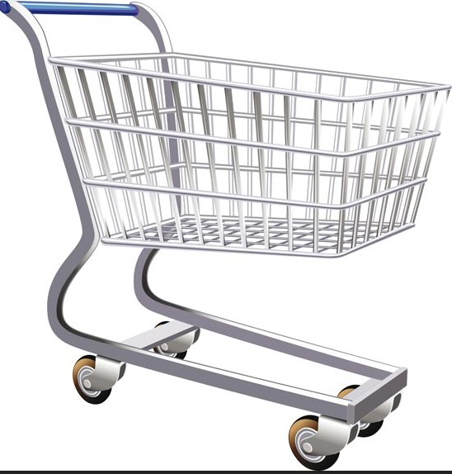
Static Electricity
Shocking Shopping Trolley
e-
e-
e-
e-
e-

Slide 15
Static Electricity
What is going to happen?

Slide 16
Static Electricity

Slide 17
Static Electricity
ORDER IS RESTORED THROUGH ELECTRICAL DISCHARGE/LIGHTNING

Slide 18

Static Electricity

Slide 19
Static Electricity
Using static electricity -explain to this man that fishing in a thunderstorm is a bad idea…
Is your answer the same, different or more detailed now?.

Slide 20
Static Electricity
Paired Comprehension Tasks
In pairs you have some information taken from various sources about static electricity. Can you use this information to label and explain the various diagrams on your sheet?

Slide 21
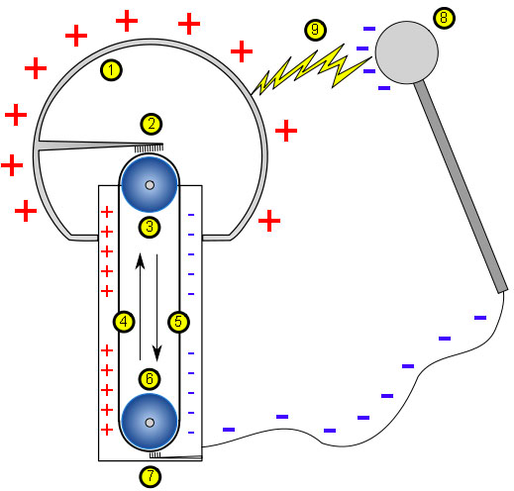
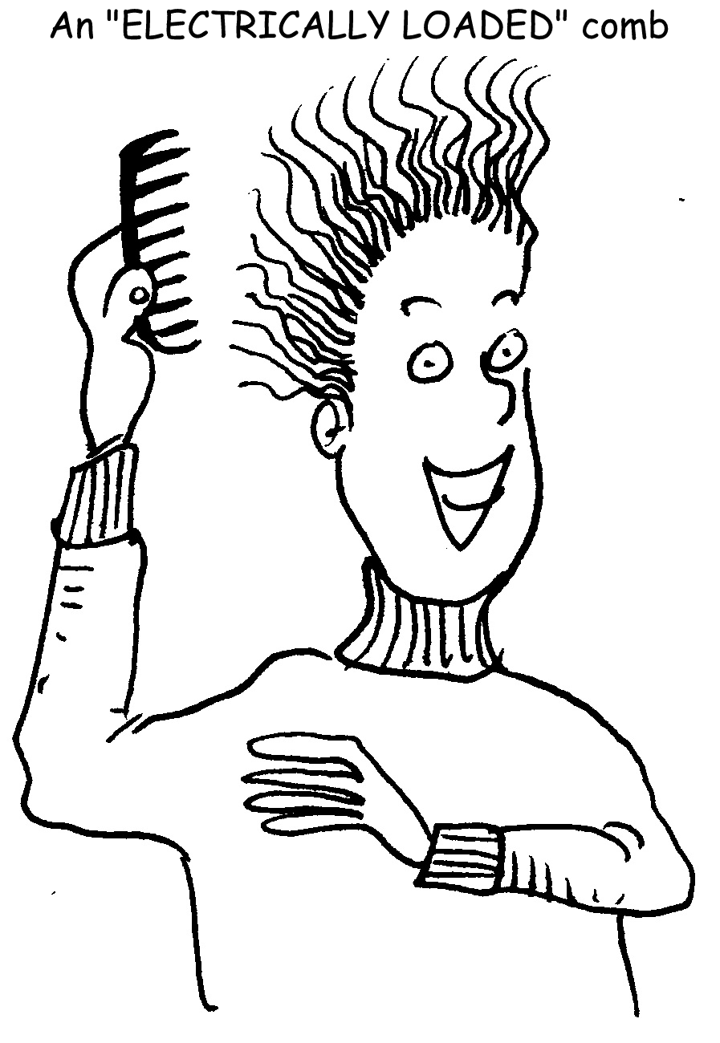
Static Electricity
Use the information and explanation sheet to help you explain these images.

Slide 22
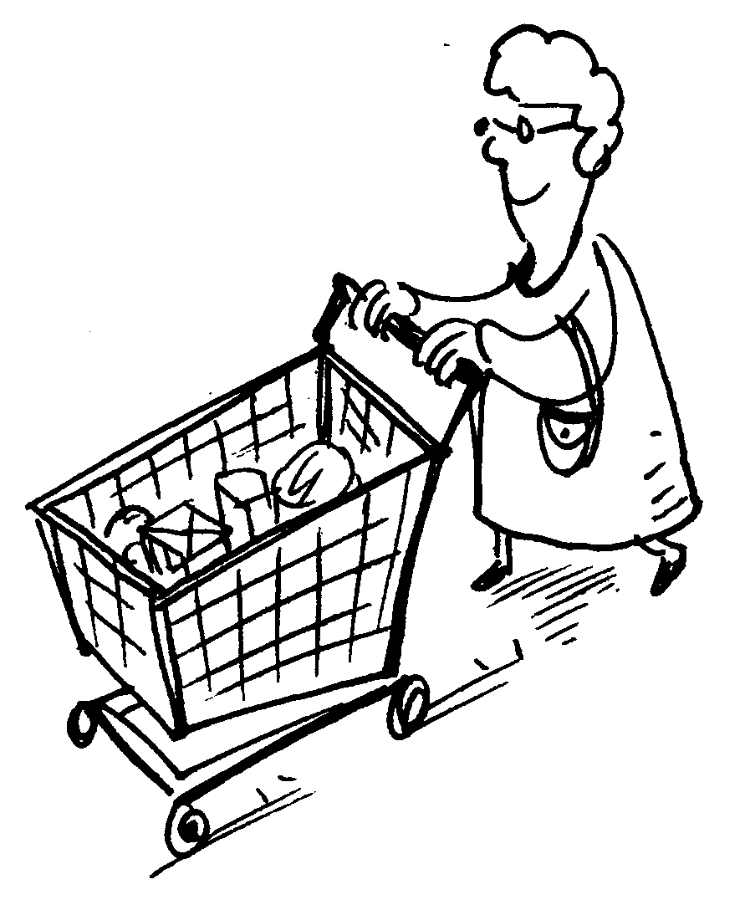

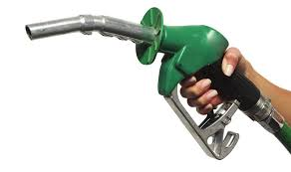
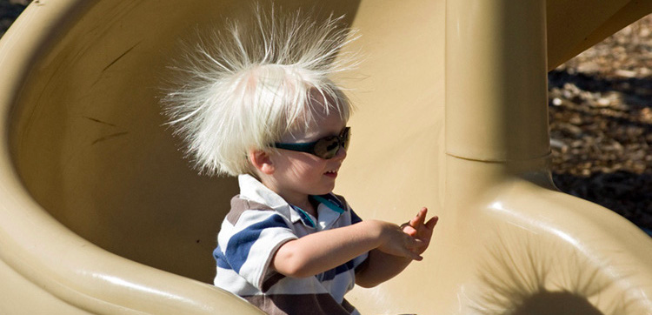
Static Electricity
Use the information and explanation sheet to help you explain these images.
Ouch!

Slide 23
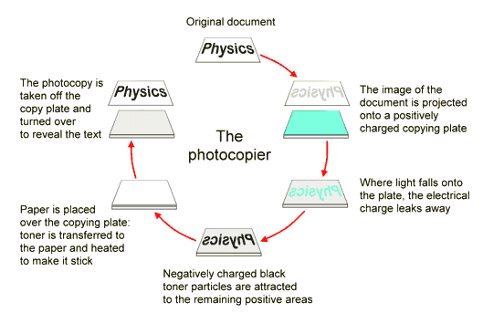
Static Electricity
Some Clever Applications
Task 2: Can you create your own version of how a photocopier works?

Slide 24
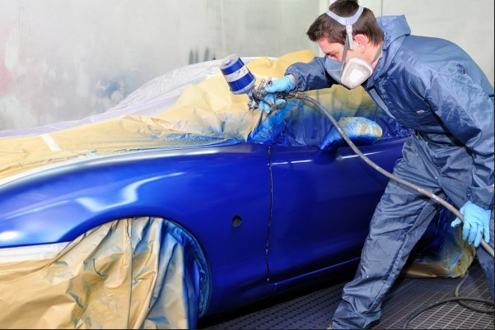
Static Electricity
Some Clever Applications
The spray gun is charged positively, which causes every paint particle to become positively charged. Like charges repel and the paint particles spread out. The object to be painted is given a negative charge and so attracts the paint particles. The advantages of using this system are that less paint is wasted, the object receives an even coat and the paint covers awkward ‘shadow’ surfaces that the operator cannot see. OR VICE VERSA.
Task 3: Can you draw and label a diagram to explain how an electrostatic paint gun works?

Slide 25

Static Electricity
Exam Questions
Work with a partner or in small groups to complete the past paper exam questions on static electricity. The mark scheme is attached to the questions to help you.

